Slide 1
ELEMENTARY STATISTICS, BLUMAN
Construct a Histogram
© 2019 McGraw-Hill Education. All rights reserved. Authorized only for instructor use in the classroom. No reproduction or further distribution permitted without the prior written consent of McGraw-Hill Education.

Slide 2
Objectives for this PowerPoint
Learn how to construct a Histogram

Slide 3
Definition
A Histogram is a graph that displays the data by using contiguous vertical bars (unless the frequency of a class is zero) of various heights to represent the frequencies of the classes.
Its purpose is to provide us with a graphical display of he distribution of a data set.

Slide 4
Data
The number of members of the 2016 United States electoral
College for the election of the President in a grouped frequency
Distribution.
Limits | Boundaries | Frequency
3 to 10 | 2.5 to 10.5 | 34
11 to 18 | 10.5 to 18.5 | 11
19 to 26 | 18.5 to 26.5 | 2
27 to 34 | 26.5 to 34.5 | 2
35 to 42 | 34.5 to 42.5 | 1
43 to 50 | 42.5 to 50.5 | 0
51 to 58 | 50.5 to 58.5 | 1

Slide 5
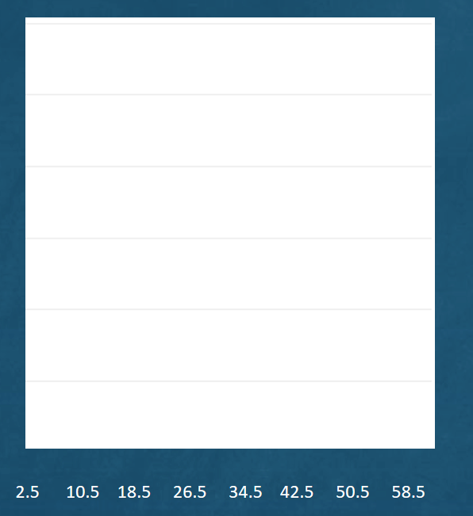
Horizontal Axis
Start with a blank sheet of paper. Along the horizontal axis put the boundaries. Our histogram needs to convey more meaning than just displaying the boundaries. The boundaries represent groupings of the number of electorates. The histogram should be labeled according to the variable that is being studied. We will evenly space the horizontal axis with the boundaries of he grouped frequency distribution.

Slide 6
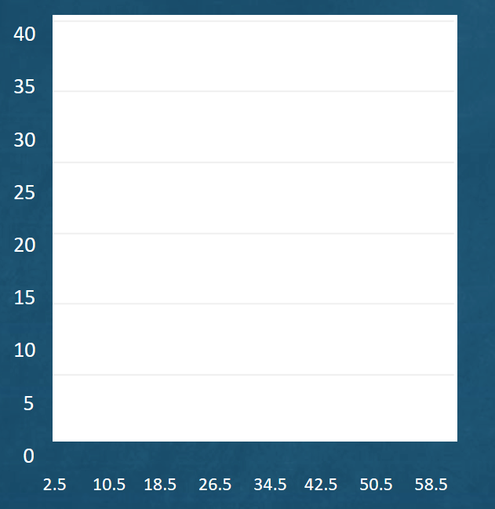
Vertical Axis
The vertical axis will be labeled according to the frequencies of the grouped frequency distribution. The frequencies go from 0 to 34. We have selected a scale from 0 to 40 and marked the vertical axis by 5s. It is important that the vertical axis starts at 0. We must portray an accurate proportionality between the classes.

Slide 7
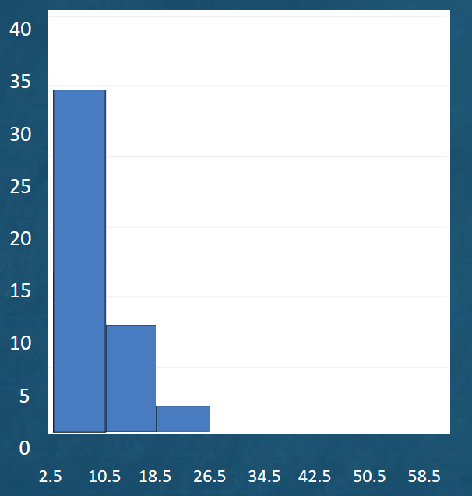
Draw Histogram Bars
The class that extends from 2.5 to 10.5 has a frequency of 34. We will draw a vertical bar that spans the width of the 1st class with the height of 34.
The 2nd class has a frequency of 11. We will draw an adjacent, contiguous vertical bar that spans the width of the 2nd class with the height of 11.
The 3rd class has a frequency of 2.
Continue this process until the entire histogram is completed.

Slide 8
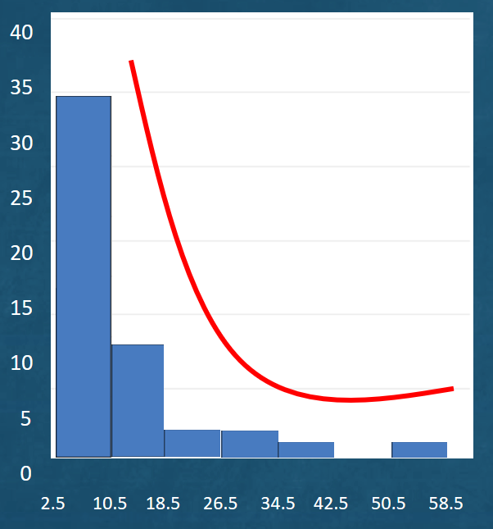
J-shaped Histogram
We can now get an impression of the distribution of the data set at a quick glance. Note that the most frequent class is the 1st class which extends from 2.5 to 10.5.
This particular distribution possesses what is referred to as a reverse j-shape.
Jump to long description

Slide 9
Summary
In this PowerPoint we learned how to construct a Histogram.

Slide 10
Appendix of Image Long Descriptions

Slide 11
J-shaped Histogram - Appendix
The first bar on left goes from 2.5 to 10.5 with height 34. The second bar goes from 10.5 to 18.5 with height 11. The third bar goes from 18.5 to 26.5 with a height of 2. The fourth bar goes from 26.5 to 34.5 with a height of 2. The fifth bar goes from 34.5 to 42.5 with a height of 1. The sixth bar goes from 42.5 to 50.5 with a height of 0. The seventh bar goes from 50.5 to 58.5 with a height of 1.
Jump to the image

